Slide 1
Designing System Architecture

Slide 2
The Design Process
Design is the creative process of figuring out how to implement all of the customer’s requirements; the resulting plan is also called the design
Early design decisions address the system’s architecture
Later design decisions address how to implement the individual units

Slide 3
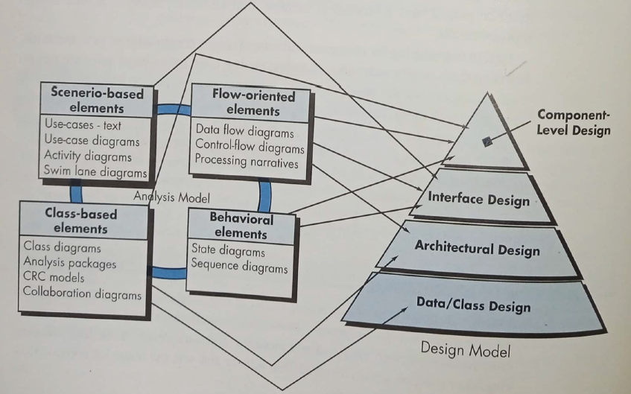
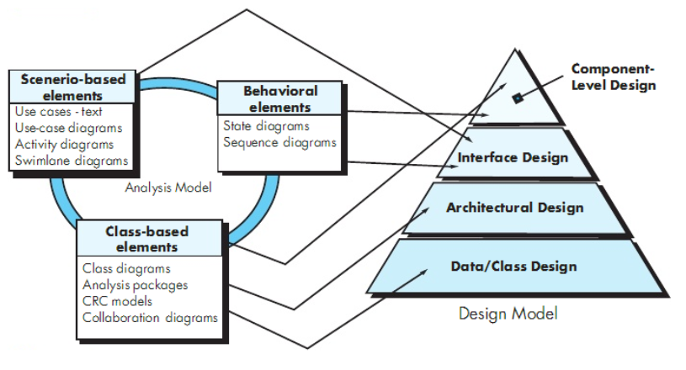
Translating Requirements to Design

Slide 4
Design or Requirements?
A room for three children to play and a separate place for them to sleep
A room for parents
A room for cooking
Heating for the winter and cooling for the summer
Indoor water and electricity

Slide 5
Multiple Designs?
Maximize playing area
Minimize playing area
Large bedrooms
Two storey house
Single storey house
Which is the best design?
Will a proposed solution result in modified requirements?

Slide 6
The Design Process Design is a Creative Process
Design is an intellectually challenging task
Numerous possibilities the system must accommodate
Nonfunctional design goals (e.g., ease of use, ease to maintain)
External factors (e.g., standard data formats, government regulations)
We can improve our design by studying examples of good design
Most design work is routine design, solve problem by reusing and adapting solutions from similar problems

Slide 7
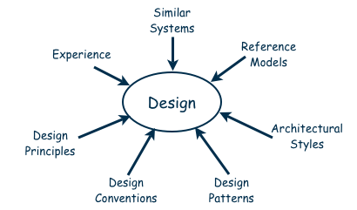
The Design Process Design is a Creative Process (continued)
Many ways to leverage existing solutions
Cloning: Borrow design/code in its entirety, with minor adjustments
Reference models: Generic architecture that suggests how to decompose the system

Slide 8
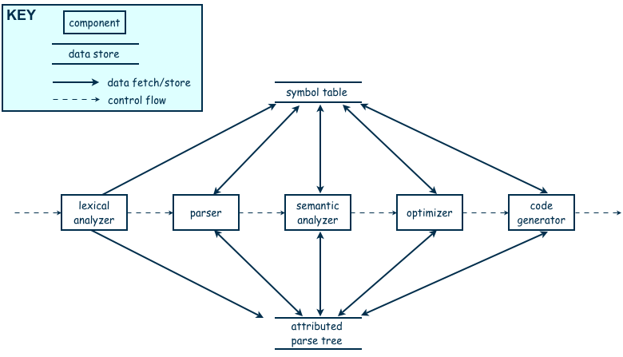
The Design Process Design is a Creative Process (continued)
Reference model for a compiler

Slide 9
The Design Process Design is a Creative Process (continued)
More typically, a reference model will not exist for the problem
Software architectures have generic solutions too, referred to as architectural styles
Focusing on one architectural style can create problems
Good design is about selecting, adapting, and integrating several architectural design styles to produce the desired result

Slide 10
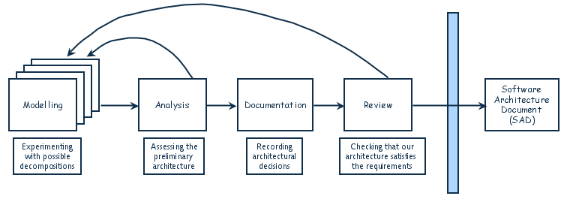
The Design Process Design is an Iterative Process (continued)
The designers move back and forth among activities involving:
Understanding requirements, proposing solutions, testing feasibility of a solution, presenting possibilities to the customers, documenting the design for programmers
The final outcome is the software architecture document (SAD)

Slide 11
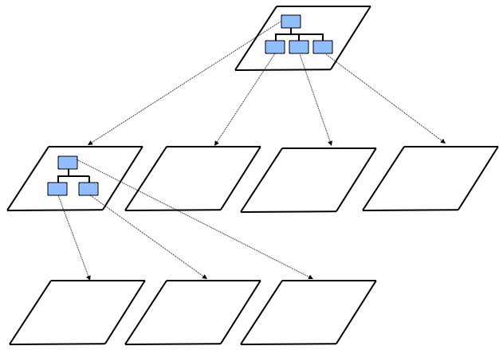
Decomposition and Views
High-level description of system’s key elements
Creating a hierarchy of information with increasing details
Top
level
First level of
decomposition
Second level of
decomposition

Slide 12
Decomposition and Views Popular Design Methods
Some design problems have no existing solutions
Designers must decompose to isolate key problems
Some popular design methods:
Functional decomposition
Feature-oriented decomposition
Data-oriented decomposition
Event-oriented decomposition
Object-oriented decomposition

Slide 13
Decomposition and Views Popular Design Methods
Functional decomposition
partitions functions or requirements into modules
begins with the functions that are listed in the requirements specification
lower-level designs divide these functions into subfunctions, which are then assigned to smaller modules
describes which modules (subfunctions) call each other

Slide 14
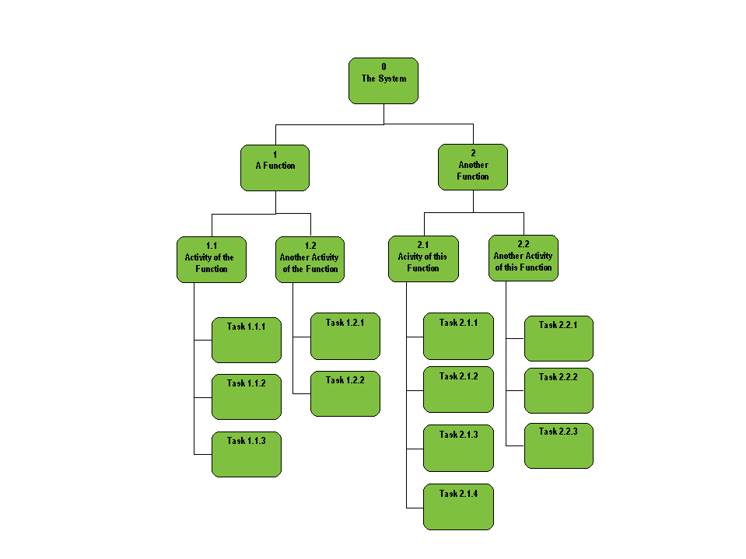
Quiz System
Student Tasks Management
Submission Management
Submission Verification
Submission Storage
Quiz Conduction and Display
Faculty Tasks Management
User Management
Quiz Management
Quiz Generation
Question Management
Report Management
Grading
Image source: http://afis.ucc.ie/gkiely/IS1100_OLD/Lectur8.gif
Attempt Reporting

Slide 15
Functional Decomposition Example
Student Registration System
Data Entry Validation
Transaction Verification
Report Generation
Data Updation
Student Data Validation
Course Data Validation
Transaction Checks
Addition Modules
Deletion Module

Slide 16
Decomposition and Views Popular Design Methods (continued)
A design is modular when each activity of the system is performed by exactly one software unit, and when the inputs and outputs of each software unit are well-defined
A software unit is well-defined if its interface accurately and precisely specifies the unit’s externally visible behavior

Slide 17
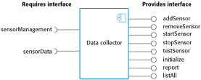

Decomposition and Views Sidebar 5.2 Component-based Software Engineering
Component-based software engineering (CBSE) is a method of software development whereby systems are created by assembling together preexisting components
A component is “a self-contained piece of software with a well-defined set of interfaces” that can be developed, bought, and sold as a distinct entity
The goal of CBSE is to support the rapid development of new systems, by reducing development to component integration, and to ease the maintenance of such systems by reducing maintenance to component replacement
At this point, APIs are used as constructs to abstract complex code

Slide 18
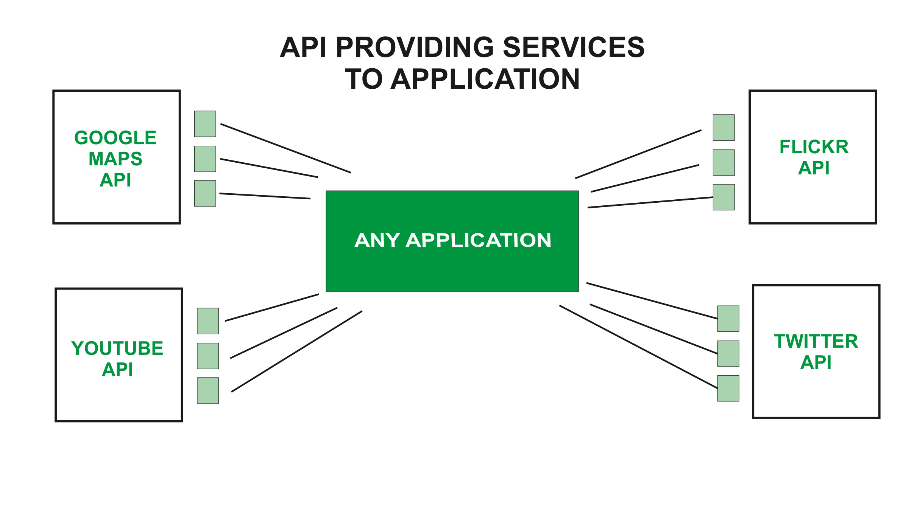
Example
Source: https://www.geeksforgeeks.org/what-is-web-api-and-why-we-use-it/

Slide 19
Design Methodology
We have an abstract description of a solution to our customer’s problem, a software architectural design, a plan for decomposing the design into software units and allocating the system’s functional requirements to them
No distinct boundary between the end of the architecture-design phase and the start of the module-design phase
No comparable design recipes for progressing from a software unit’s specification to its modular design
The process taken towards a final solution is not as important as the documentation produced

Slide 20
Design Methodology
Design decisions are periodically revisited and revised
Refactoring
to simplify complicated solutions or to optimize the design

Slide 21
Design Documentation
The details of the system architecture is documented in Software Architecture Document (SAD)
SAD serves as a bridge between the requirements and the design
Detailed (or module) design acts as a bridge from architecture design to code
Many ways to document the design
Design by contract: a particular approach that uses the documentation not only to capture the design but also to encourage interaction among developers

Slide 22
Design Documentation Design by Contract
In design by contract, each module has an interface specification that precisely describes what the module is supposed to do
Meyer (1997) suggests that design by contract helps ensure that modules interoperate correctly
This specification, called a contract, governs how the module is to interact with other modules and systems
Such specification cannot guarantee a module’s correctness, but it forms a clear and consistent basis for testing and verification
The contract covers mutual obligations (the preconditions), benefits (the postconditions), and consistency constraints (called invariants)
Together, these contract properties are called assertions

Slide 23
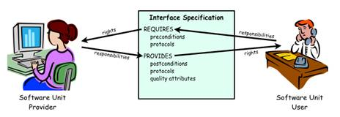
Design Documentation Design by Contract (continued)
Design contract between software provider and user

Slide 24
Architectural Styles and Strategies
Pipe-and-Filter
Client-Server
Peer-to-Peer
Publish-Subscribe
Repositories
Layering
Microservices
Call-Return

Slide 25
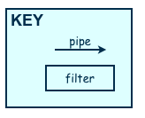
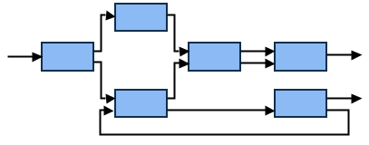
Architectural Styles and Strategies Pipe-and-Filter
The system has
Streams of data (pipe) for input and output
Transformation of the data (filter)
KEY
pipe

Slide 26
Architectural Styles and Strategies Pipe-and-Filter (continued)
Several important properties
The filters can be reused easily on other systems
System evolution is simple
Allow concurrent execution of filters
Drawbacks
Not good for handling interactive application

Slide 27
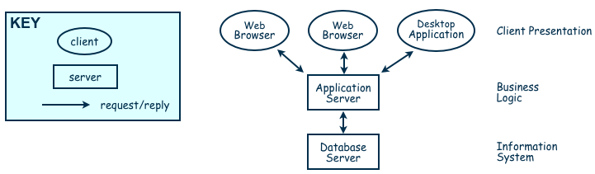
Architectural Styles and Strategies Client-Server
Two types of components:
Server components offer services
Clients access them using a request/reply protocol
Client may send the server an executable function, called a callback
The server subsequently calls under specific circumstances

Slide 28
Architectural Styles and Strategies Peer-to-Peer (P2P)
Each component acts as its own process and acts as both a client and a server to other peer components.
Any component can initiate a request to any other peer component.
Characteristics
Scale up well
Increased system capabilities
Highly tolerant of failures
Examples: Napster, Kaaza, BitTorrent

Slide 29
Architectural Styles and Strategies Peer-to-Peer (P2P)
When NOT to use:
When file contents change frequently (e.g. prices)
When sharing speed has importance (e.g. large files are needed quickly)
File quality is critical
When trust between peers is required (e.g. the content is protected)

Slide 30
Architectural Styles and Strategies Publish-Subscribe
Components interact by broadcasting and reacting to events
Component expresses interest in an event by subscribing to it
When another component announces (publishes) that event has taken place, subscribing components are notified
Implicit invocation is a common form of publish-subscribe architecture
Registering: subscribing component associates one of its procedures with each event of interest (called the procedure)
Characteristics
Strong support for evolution and customization
Easy to reuse components in other event-driven systems
Need shared repository for components to share persistent data
Difficult to test all subscribers

Slide 31
Architectural Styles and Strategies Repositories
Two components
A central data store
A collection of components that operate on it to store, retrieve, and update information (data accessors)
The challenge is deciding how the components will interact
A traditional database: transactions trigger process execution
A blackboard: the central store controls the triggering process
Knowledge sources: information about the current state of the system’s execution that triggers the execution of individual data accessors

Slide 32
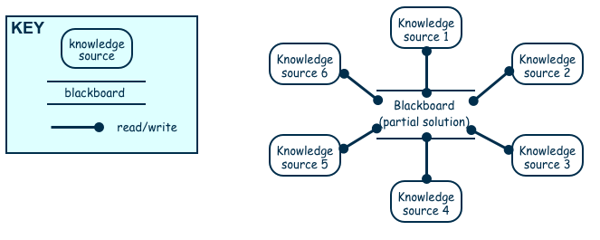
Architectural Styles and Strategies Repositories (continued)
Openness?
Data representation is made available to various programmers (vendors) so they can build tools to access the repository
But also a disadvantage: the data format must be acceptable to all components

Slide 33
Architectural Styles and Strategies Layering
Layers are hierarchical
Each layer provides service to the one outside it and acts as a client to the layer inside it
Layer bridging: allowing a layer to access the services of layers below its lower neighbor
The design includes protocols
Explain how each pair of layers will interact
Advantages
High levels of abstraction
Relatively easy to add and modify a layer
Disadvantages
Not always easy to structure system layers
System performance may suffer from the extra coordination among layers

Slide 34
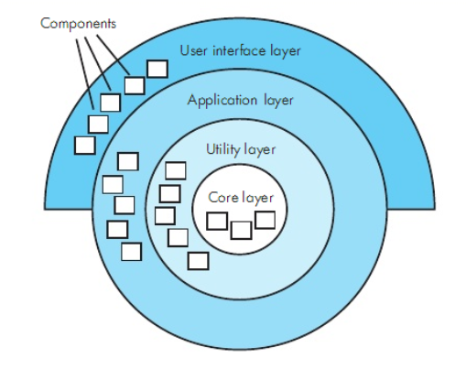
Architectural Styles and Strategies Example of Layering System

Slide 35
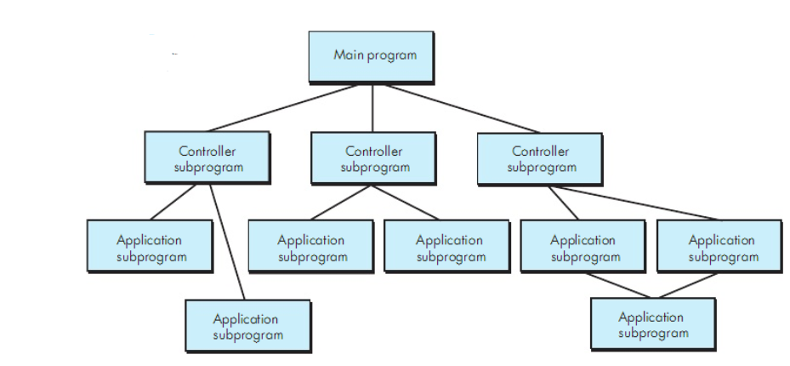
Architecture Styles and Strategies Call and Return
Main program/sub program
Remote procedure call

Slide 36
Microservices Architecture
API Gateway
Microservice 1
DB1
Microservice 2
DB2
Client Apps
Microservice 3
DB3
Microservice 4
DB4

Slide 37
Architectural Styles and Strategies Combining Architectural Styles
Actual software architectures rarely based on purely one style
Architectural styles can be combined in several ways
Use different styles at different layers (e.g., overall client-server architecture with server component decomposed into layers)
Use mixture of styles to model different components or types of interaction (e.g., client components interact with one another using publish-subscribe communications
If architecture is expressed as collection of models, documentation must be created to show relation between models

Slide 38
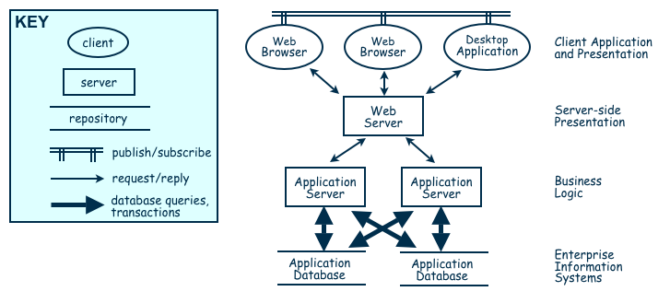
Architectural Styles and Strategies Combination of WHICH Architecture Styles?
Combination of Publish-Subscribe, Client-Server, Layering, Repository

Slide 39
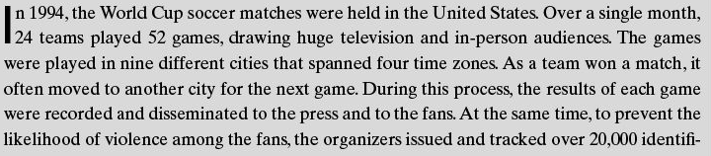
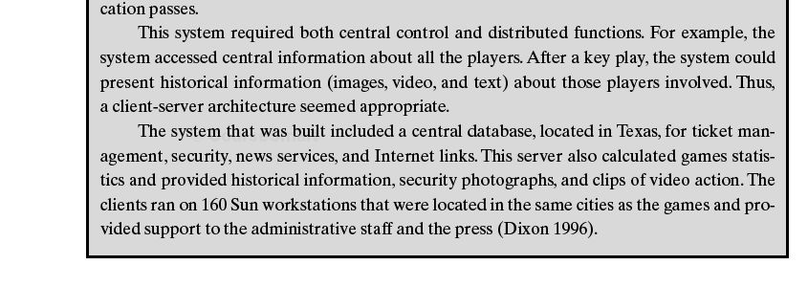
Architectural Styles and Strategies The World Cup System
Which
?
The center

Slide 40
Architectural Styles and Strategies Sidebar 5.3 The World Cup Client-Server System
Over one month in 1994, the World Cup soccer matches were held in the United States. Design system issues:
24 teams played 52 games
nine different cities that spanned four time zones
results of each game were recorded and disseminated to the press and to the fans
To deter violence among the fans, the organizers issued and tracked over 20,000 identification passes
This system required both central control and distributed functions. Thus, a client-server architecture seemed appropriate.
The system that was built included a central database, located in Texas, for ticket management, security, news services, and Internet links. This server also calculated games statistics and provided historical information, security photographs, and clips of video action.
The clients ran on 160 Sun workstations that were located in the same cities as the games and provided support to the administrative staff and the press

Slide 41
Architectural Styles and Strategies Sidebar 5.4 Napster’s P2P Architecture
Peers are typically users’ desktop computer systems running general-purpose computing applications (email, word processors, Web browsers, etc.)
Many user systems do not have stable Internet protocol (IP) addresses
Not always available to the rest of the network
Most users are not sophisticated; they are more interested in content than in the network’s configuration and protocols
Great variation in methods for accessing the network, from slow dial-up lines to fast broadband connections
Napster’s sophistication comes from its servers, which organize requests and manage content, with actual content provided by users, shared from peer to peer, and the sharing goes to other (anonymous) users, not to a centralized file server
If the file content changes frequently, sharing speed is key, file quality is critical, or one peer needs to be able to trust another, a centralized server architecture may be more appropriate

Slide 42
Architecture Evaluation

Slide 43
Achieving Quality Attributes
Architectural styles provide general beneficial properties. Quality attributes also need to be supported:
Modifiability
Performance
Security
Reliability
Robustness
Usability
Business goals
Characteristics that users want to see in products that we build

Slide 44
Achieving Quality Attributes Modifiability
Design must be easy to change
Two classifications of affected software units:
Directly affected
Indirectly affected
Directly affected units’ responsibilities change to accommodate a system modification
Anticipate expected changes
Value cohesion
Maintain generality
Indirectly affected units’ responsibilities do not change, but implementations must be revised
Lower coupling
Interact through interfaces
Employ multiple interfaces
Cost spent after first version?

Slide 45
Achieving Quality Attributes Performance
Performance attributes describe constraints on system speed and capacity:
Response time: How fast does our software respond to requests?
Throughput: How many requests can it process per minute?
Load: How many users can it support before response time and throughput start to suffer?

Slide 46
Achieving Quality Attributes Performance
Reduce computational overhead?
Tactics for improving performance include:
Improve utilization of resources
Manage resource allocation more effectively
First-come/first-served: Requests are processed in the order in which they are received
Explicit priority: Requests are processed in order of their assigned priorities
Earliest deadline first: Requests are processed in order of their impending deadlines
Reduce demand for resources
Increase resources? Multiple copies? Additional processors, memory? Lower sample rate?

Slide 47
Achieving Quality Attributes Security
Two key architectural characteristics particularly relevant to security: immunity and resilience
Immunity: ability to thwart an attempted attack
The architecture encourages immunity by:
Ensuring all security features are included in the design
Minimizing exploitable security weaknesses
Resilience: ability to recover quickly and easily from an attack
The architecture encourages resilience by:
Segmenting functionality to contain attack
Enabling the system to quickly restore functionality

Slide 48
Achieving Quality Attributes Reliability
A software system is reliable if it correctly performs its required functions under assumed conditions
Is the software internally free of errors?
A fault is the result of human error, compared to a failure, which is an observable departure from required behaviour
Software is made more reliable by preventing or tolerating faults

Slide 49
Achieving Quality Attributes Reliability (continued)
Passive fault detection: wait until fault occurs during execution
Active fault detection: periodically check for symptoms or try to anticipate when failures will occur
Exceptions: situations that cause the system to deviate from its desired behaviour
Include exception handling in design to handle exception and return system to acceptable state
Typical exceptions include:
Failing to provide a service
Providing the wrong service
Corrupting data
Violating a system invariant (e.g.; security property)
Deadlocking

Slide 50
Achieving Quality Attributes Reliability (continued)
Fault recovery: handling fault immediately to limit damage
Fault recovery tactics:
Undoing transactions: manage a series of actions as a single transaction that are easily undone if a fault occurs midway through the transaction
Checkpoint/rollback: software records a checkpoint of current state; rolls back to that point if system gets in trouble
Backup: system automatically substitutes faulty unit with backup
Degraded service: returns to previous state, offers degraded version of the service
Correct and continue: detects the problem and treats the symptoms
Report: system returns to its previous state and reports the problem to an exception-handling unit

Slide 51
Achieving Quality Attributes Robustness
A system is robust if it includes mechanisms for accommodating or recovering from problems in the environment or in other unit
Mutual suspicion: each software unit assumes that the other units contain faults
Robustness tactics differ from reliability tactics
Recovery tactics are similar:
Rollback to checkpoint state
Abort a transaction
Initiate a backup unit
Provide reduced service
Correct symptoms and continue processing
Trigger an exception

Slide 52
Achieving Quality Attributes Usability
Usability reflects the ease in which a user is able to operate the system
User interface should reside in its own software unit
Some user-initiated commands require architectural support
There are some system-initiated activities for which the system should maintain a model of its environment

Slide 53
Achieving Quality Attributes Business Goals
Business Goals are quality attributes the system is expected to exhibit (e.g., minimizing the cost of development and time to market)
Buy vs. Build
Save development time, money
More reliable
Existing components create constraints; vulnerable to supplier
Initial development vs. maintenance costs
Save money by making system modifiable
Increased complexity may delay release; lose market to competitors
New vs. known technologies
Acquiring expertise costs money, delays product release
Either learn how to use the new technology or hire new personnel
Eventually, we must develop the expertise ourselves

Slide 54
Architecture Evaluation and Refinement
Design is iterative: we propose design decisions, assess, make adjustments, and propose more decisions
Many techniques to evaluate the design:
Trade-off analysis
Cost-benefit analysis
Prototyping

Slide 55
Architecture Evaluation and Refinement Trade-off Analysis
Often several alternative designs to consider
professional duty to explore design alternatives and not simply implement the first design that comes to mind
different members of design team may promote competing designs
need a measurement-based method for comparing design alternatives

Slide 56

Architecture Evaluation and Refinement One Specification, Many Designs
One specification, many designs: to see how different designs can be used to solve the same problem

Slide 57
Architecture Evaluation and Refinement One Specification, Many Designs
One specification, many designs: to see how different designs can be used to solve the same problem
Shaw and Garlan present four different architectural designs to implement KWIC (Key Word in Context problem)
shared data
data abstraction
implicit invocation
pipe and filter

Slide 58
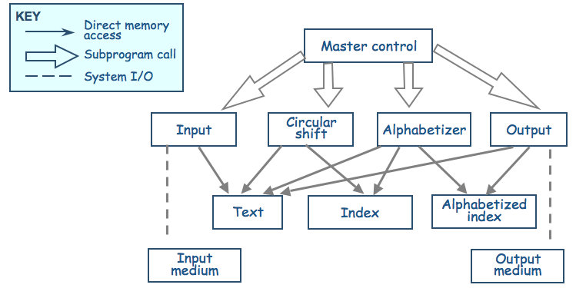
Architecture Evaluation and Refinement One Specification, Many Designs (continued)
Shared data solution
Four functional parts: input, circular shift, alphabetize, and output

Slide 59
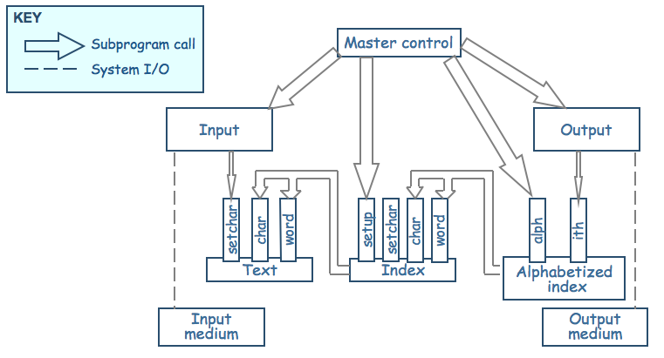
Architecture Evaluation and Refinement One Specification, Many Designs (continued)
Data-module (data abstraction) solution
Modules form data abstraction (hide data representation)
Circular-shift module
Alphabetic-shift module

Slide 60
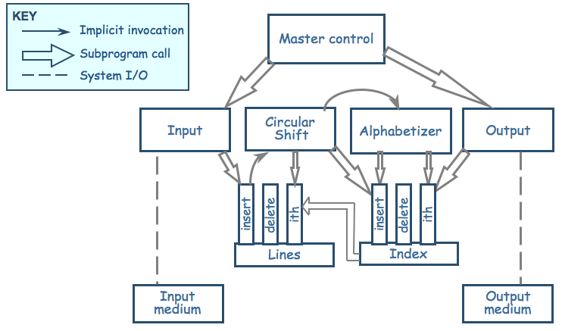
Architecture Evaluation and Refinement One Specification, Many Designs (continued)
Implicit Invocation solution: Data is stored in ADTs, the decomposition process is similar to solution 1

Slide 61
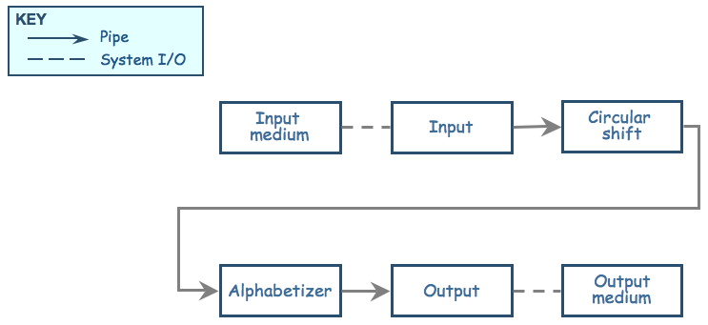
Architecture Evaluation and Refinement One Specification, Many Designs (continued)
Pipe-and-filter solution: The sequence of processing is controlled by the sequence of filters

Slide 62
Architecture Evaluation and Refinement One Specification, Many Designs (continued)

Slide 63
Architecture Evaluation and Refinement One Specification, Many Designs (continued)
Comparison of KWIC solutions on the basis of important attributes
Attribute | Shared Data | Data Abstraction | Implicit Invocation | Pipe and Filter
Easy to change Algorithm | - | - | + | +
Easy to Change Data | - | + | - | -
Easy to Add Functionality | + | - | + | +
Performance | - | - | + | +
Efficient Data Rep | + | + | + | -
Easy to Reuse | - | + | - | +
+ means that the design has the attribute
- means that the attribute is not an aspect of the design

Slide 64
Architecture Evaluation and Refinement One Specification, Many Designs (continued)
Weighted comparison of KWIC solutions
Attribute | Priority | Shared data | Data abstraction | Implicit invocation | Pipe and filter
Easy to change algorithm | 1 | 1 | 2 | 4 | 5
Easy to change data representation | 4 | 1 | 5 | 2 | 1
Easy to change function | 3 | 4 | 1 | 4 | 5
Good performance | 3 | 5 | 4 | 2 | 2
Easy to reuse | 5 | 1 | 4 | 2 | 5
Highest Priority of an attribute = 5, Lowest priority = 1. For example, Reusability is the most desirable attribute here
Numbers in column 3 to 6 represent the extent to which a design satisfies the characteristic of the corresponding attribute. 1 being the lowest, 5 being the highest

Slide 65
Architecture Evaluation and Refinement One Specification, Many Designs (continued)
Weighted comparison of KWIC solutions
Attribute | Priority | Shared data | Data abstraction | Implicit invocation | Pipe and filter
Easy to change algorithm | 1 | 1 | 2 | 4 | 5
Easy to change data representation | 4 | 1 | 5 | 2 | 1
Easy to change function | 3 | 4 | 1 | 4 | 5
Good performance | 3 | 5 | 4 | 2 | 2
Easy to reuse | 5 | 1 | 4 | 2 | 5
Multiply the priorities with ratings and sum over the design to get score for each design
For example score for pipe and filter = 1x5 + 4x1 + 3x5 + 3x2 + 5x5 = 55.
Pick the design with the highest score. Here data abstraction has the highest score (57)

Slide 66
Architecture Evaluation and Refinement One Specification, Many Designs (continued)
Other attributes to consider
Modularity
Testability
Security
Ease of use
Ease of understanding
Ease of integration

Slide 67
Architecture Evaluation and Refinement Cost-Benefit Analysis
Consider a proposal to improve KWIC performance because the number of KWIC indices have increased
Eliminate noise word indices?
Change representation of indices to bin of indices?
Increase server capacity?
A cost–benefit analysis is a widely used business tool for estimating and comparing the costs and benefits of a proposed change

Slide 68
Architecture Evaluation and Refinement Computing Benefits
A cost-benefit analysis contrasts financial benefits with financial costs, both in Dollars
Costs
Development
Operational
Benefits
Reduced Operational Costs
Increased Earnings
Payback period
the length of time before accumulative benefits recover the costs of implementation

Slide 69
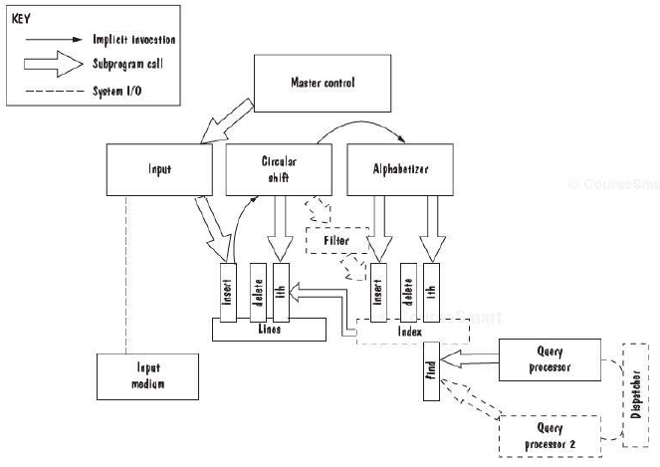
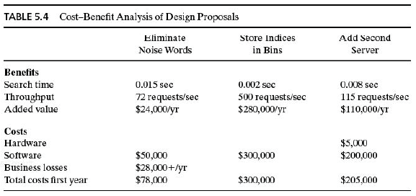

Slide 70
Architecture Evaluation and Refinement Computing Benefits (Continued)
Return on Investment (ROI)
ROI = Benefits/Cost, ROI > 1 is desired
%age gain ROI = (Benefits – Cost) / Cost x 100
Example
After five years
Cost = $ 2249559
Benefits = $ 6122893
ROI = 2.72 i.e. Total benefits are approx. 3 times the total costs
%age gain ROI = 172.19 % i.e. Your earnings are 172.19 % of the total costs

Slide 71
References
SE book by Pfleeger
SE book by Pressman
SE book by Ian Sommerville
UCF slides for SE course (a few slides have been reused)

